Slide 1

Mathis Gerdes
Rimvydas Rubavicius

Slide 2

About us: Mathis Gerdes
Degree: Physics
Nationality: German
Interest: science, philosophy, politics
Notes:
ADD interest

Slide 3

About us: Rimvydas Rubavicius
Degree: Software Engineering
Nationality: Lithuanian
Interest: History and Politics

Slide 4

Learning resources
Education is done with you, not to you

Slide 5
Tutors
Website
Handbook

Slide 6
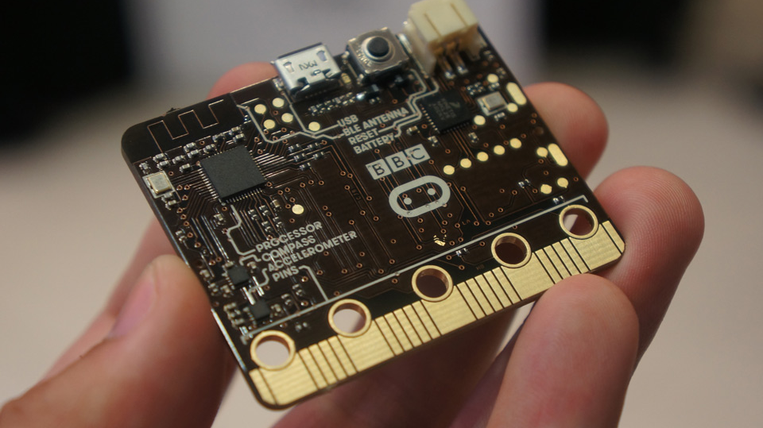
Project agenda

Slide 7
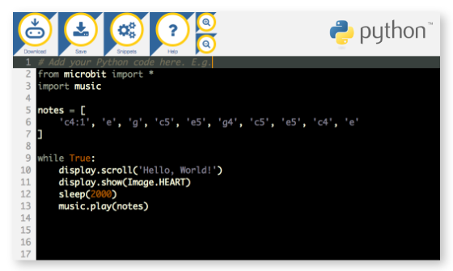
Programming with Python

Slide 8
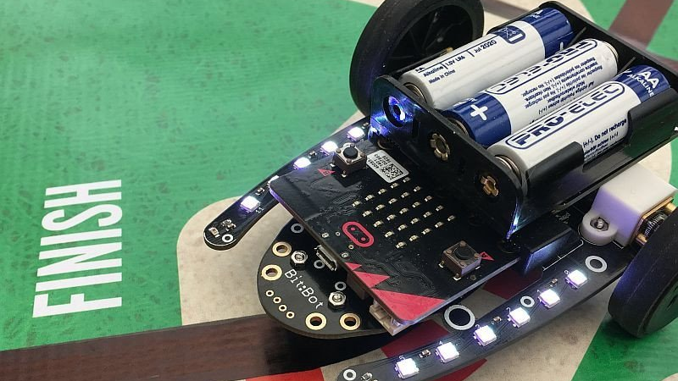
Bit:bot challenge

Slide 9

Internal showcase

Slide 10

Safety instructions

Slide 11

Lets get to work !

